Slide 1

Austin Airbnb Analysis
By: Terrence Miller

Slide 2
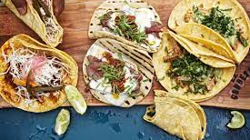
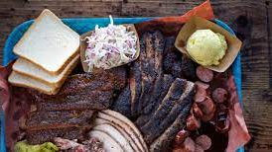
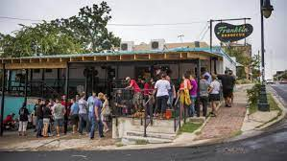

Why Austin?

Slide 3



Slide 4
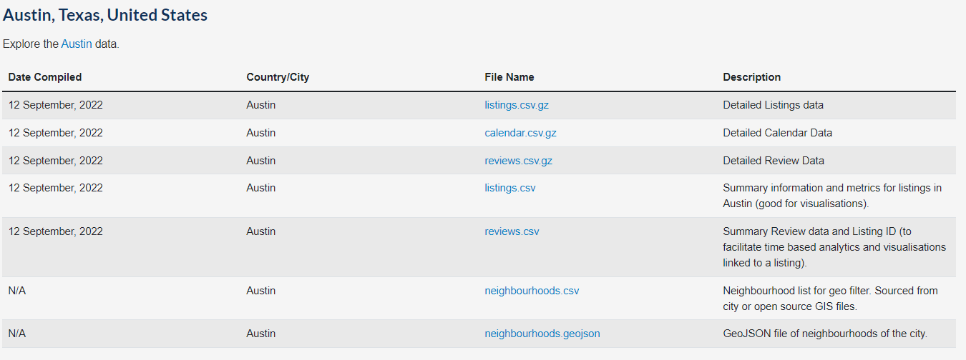
About the Dataset

Slide 5
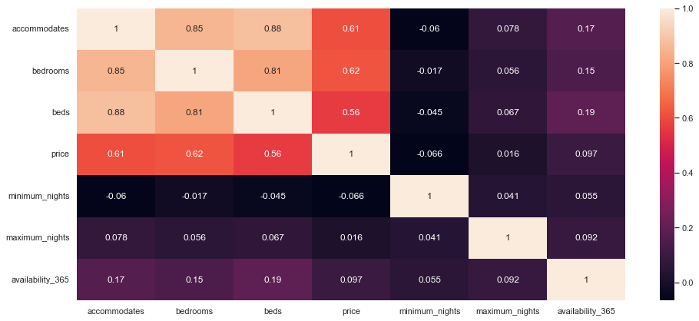
How do these relate to each other?

Slide 6
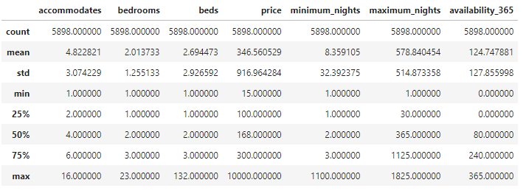
Main numerical values to focus on

Slide 7
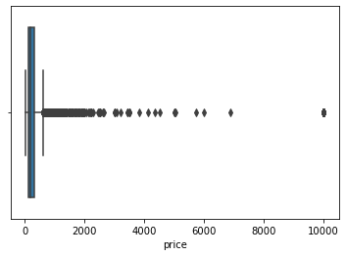
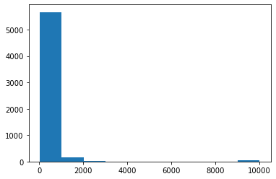
Price Outliers

Slide 8
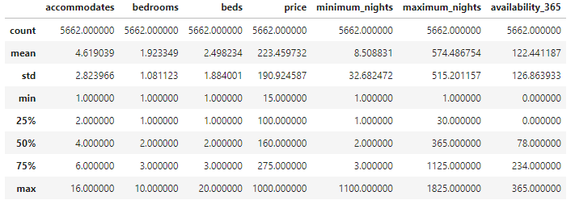
A clearer view

Slide 9
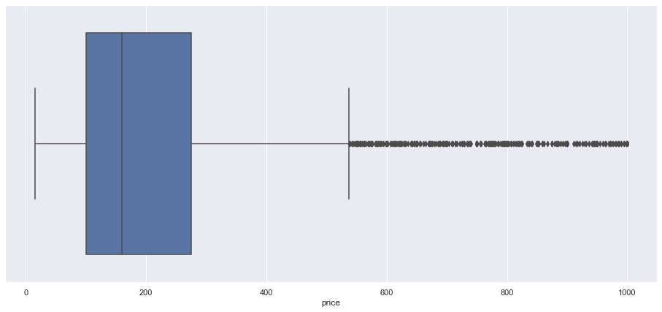

Slide 10
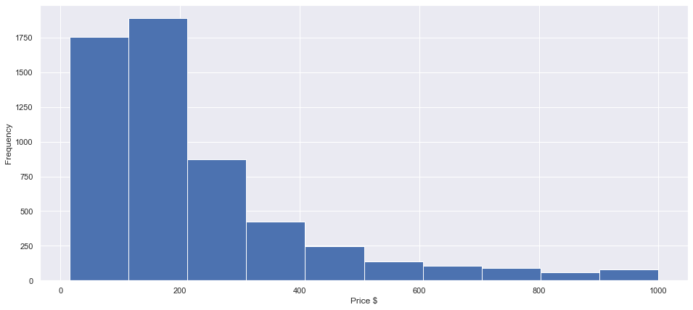

Slide 11
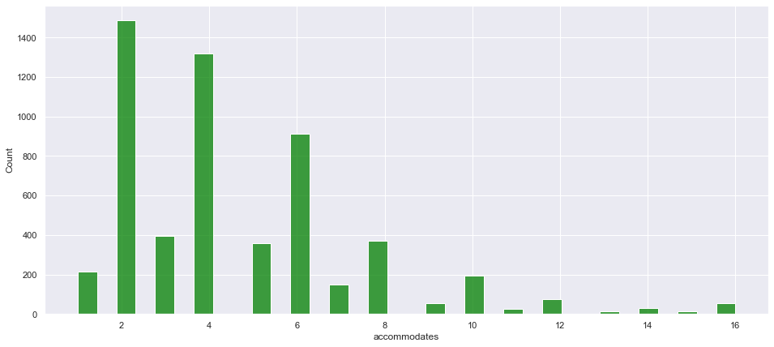
How many to accommodate?

Slide 12
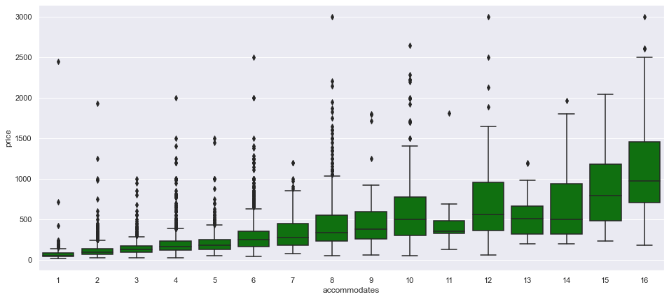
Price for that Accommodation

Slide 13
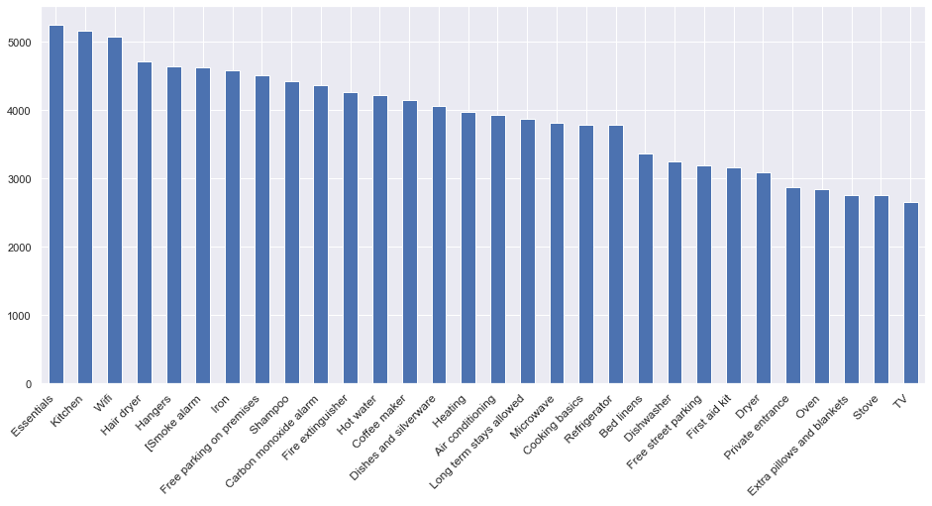
Bare necessities amenities.

Slide 14
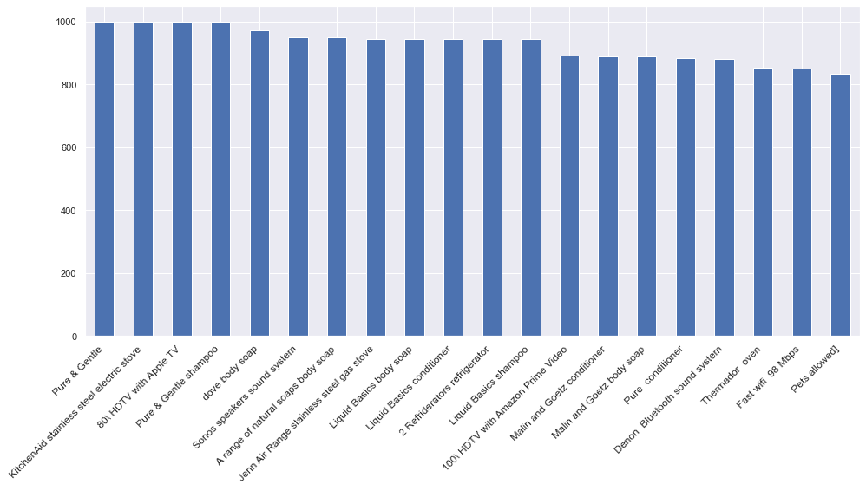

Slide 15
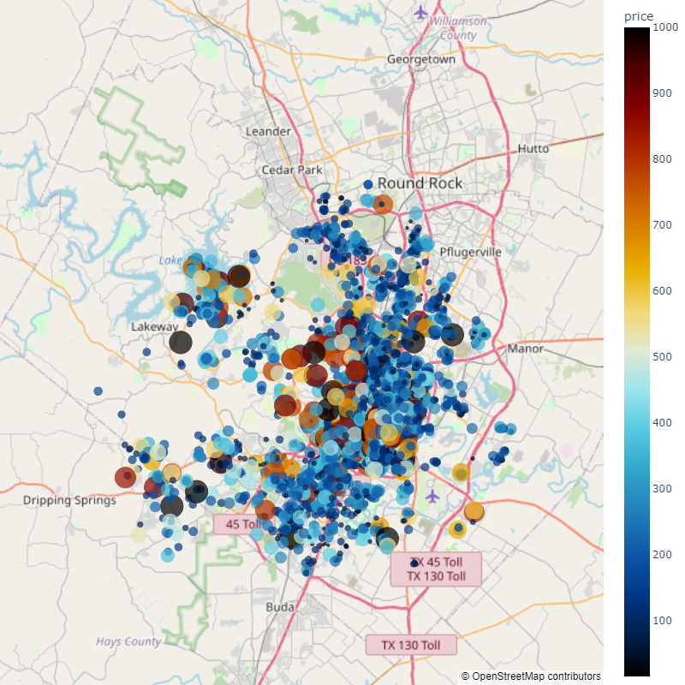
Location

Slide 16

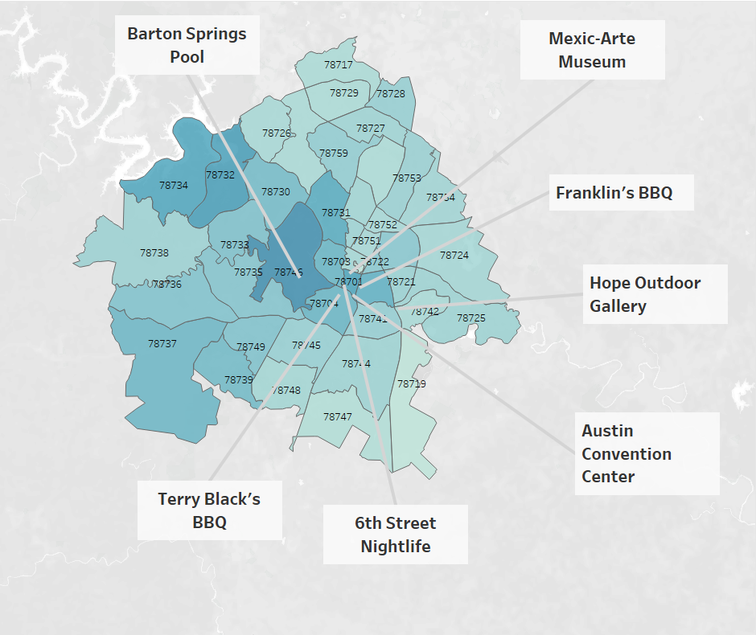




Slide 17
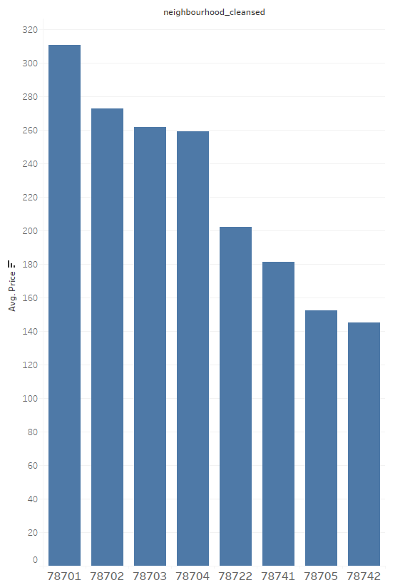

Slide 18
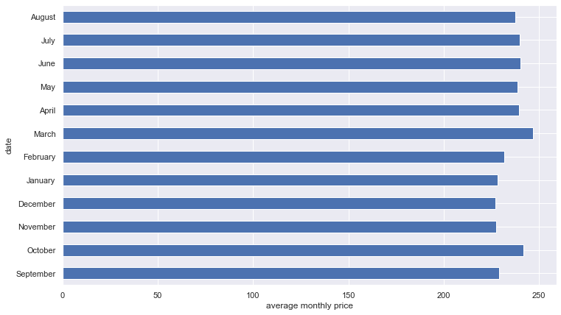
Does time of the year affect price?

Slide 19

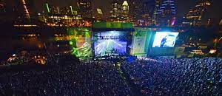
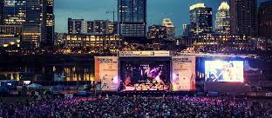


Slide 20

Next Steps
One of the biggest missing pieces from this data is the lack of historical booking data.
Group the amenities data.
See if there are any trends for hosts that are doing well
Check what users like most from their reviews

Slide 21
Thanks!
Do you have any questions?
Terrencemiller94@gmail.com
GH: https://github.com/TerrenceMiller

